Slide 1

US ACCIDENT: 2016 - 2023 Analysis
Januarius Kodzo Avorgbedor || Bolatito Akinyemi || Prosper Kofi Legbedze || Emmanuel Adebiyi
Notes:
NOTE:
To change the image on this slide, select the picture and delete it. Then click the Pictures icon in the placeholder to insert your own image.

Slide 2
Agenda
Project Background
Justification for Dataset Selection
Project Scope and Objective
Project Architecture and Tools
Data Staging
Data Processing
Processed Zone
Data Warehousing
Data Analysis
Key Insights and Recommendations
Conclusion
References

Slide 3
Project Background
Scope: Covers car accidents across 49 states in the USA.
Timeframe: Data collected from February 2016 to March 2023.
Data Collection Method:
Utilizes multiple APIs for streaming traffic incident data.
Sources include:
US and state departments of transportation
Law enforcement agencies
Traffic cameras
Traffic sensors within road networks
Dataset Size: Approximately 7.7 million accident records.
Details: https://www.kaggle.com/datasets/sobhanmoosavi/us-accidents/data

Slide 4
Justification for Dataset Selection
Data Relevance:
1. Helps in understanding accident trends over time.
2. Provides insights for improving road safety and traffic regulations.
Richness of Data:
1. Multiple factors (weather, time, location, road conditions).
2. Potential for deep analysis and visualization.
Practical Application:
1. Useful for policymakers, transport agencies, and urban planners.
2. Can aid in machine learning applications for accident prediction.

Slide 5
Objective and Project Scope
Objective
To analyze car accident trends, identify high-risk areas, and gain insights into road safety.
Project Scope
Develop a data architecture
Perform ETL (extracting, transforming, and loading) operation on data for analysis.
Derive insightful analysis and develop report dashboards for interactive insights.

Slide 6
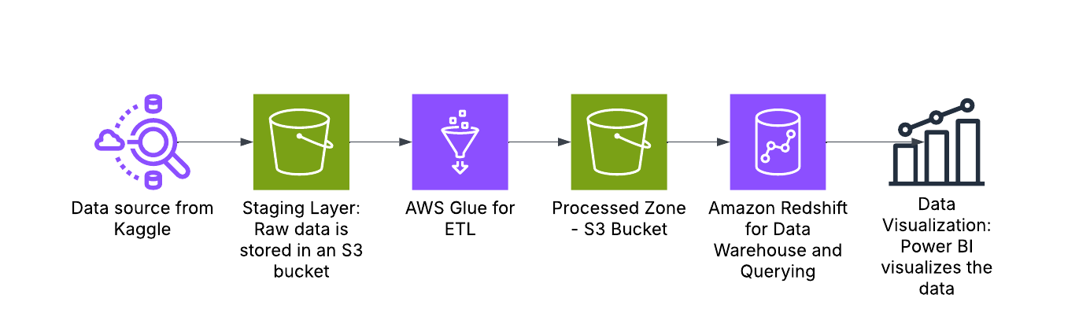
Project Architecture and Tools

Slide 7
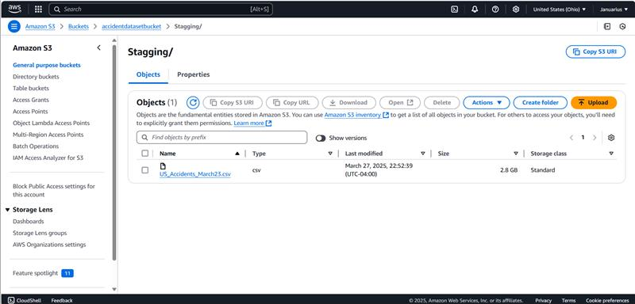
Data Staging
Dataset in CSV format was uploaded to AWS S3

Slide 8
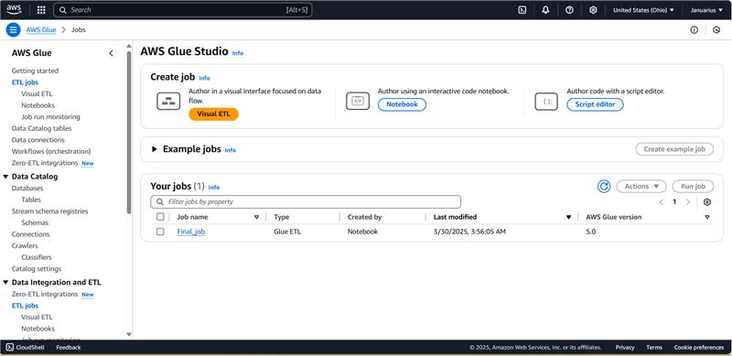
Data ETL Process

Slide 9
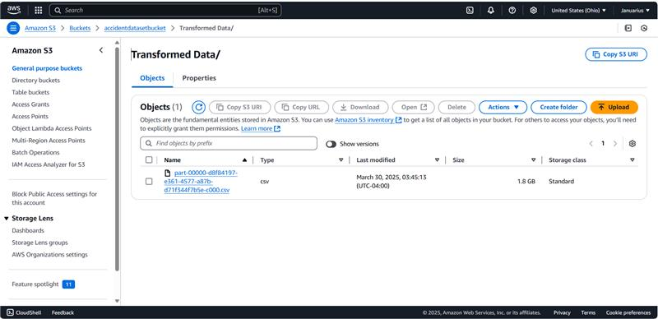
Processed Zone
Target storage for transformed data in S3

Slide 10
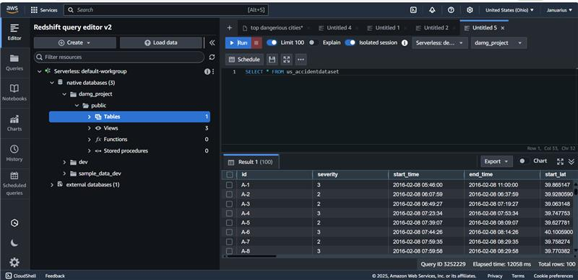
Data Warehousing

Slide 11
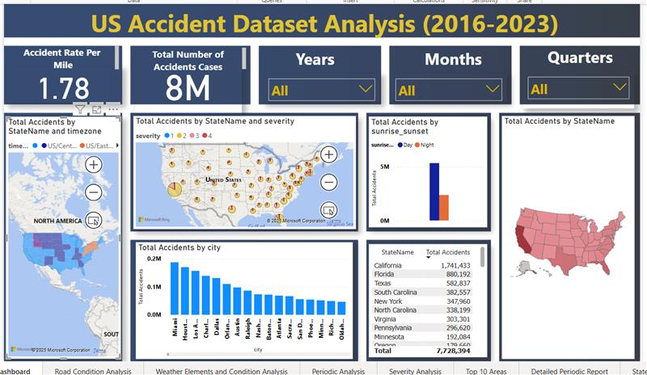
Business Intelligent (Data Analysis)

Slide 12
Key Insights and Recommendations
Major Observations
Higher accident rates in late summer and December. Significant incidents during holiday months.
The majority of accidents resulted in minor to moderate severity (Severity 2). With 1.1% classified as severe (Severity Scale: 1-4)
Top States by Accidents include California(1.74M) and Florida(880K), whilst the top cities include Miami and Houston
A significant number of the accidents occurred at “Traffic signals” (14.8%) and "Crossing" (11.31%), with minor impact from bumps and turning loops
The majority of the accidents occurred in fair weather conditions with notable spikes in incidents during severe weather (e.g., fog, rain).
Recommendations
Provide targeted safety campaigns in high-accident states and cities
Enhance safety measures for areas with high-severity cases.
Enhance infrastructure, such as signage, and improve visibility at busy crossings and around traffic signals.
Driver education programs should focus on bad weather conditions and safe driving practices.
Ongoing Monitoring of accident trends to adjust strategies proactively.

Slide 13
Conclusion
The analysis of US accident data from 2016 to 2023 has successfully provided valuable insights into the patterns and dynamics of road safety across the country.
By leveraging advanced analytical tools and methodologies, we conducted a comprehensive exploration of multifaceted datasets, revealing critical trends in accident frequency, severity, and contributing factors.
Through meticulous examination of a substantial dataset, we identified actionable recommendations aimed at enhancing road safety.
These insights are grounded in empirical evidence drawn from the analysis, highlighting the need for targeted interventions in high-accident states and cities, as well as improvements to road infrastructure and driver education.
The project not only shed light on underlying trends but also emphasized the importance of ongoing monitoring and data-driven strategies.
By focusing on these insights and recommendations, stakeholders can make informed decisions that contribute to reducing accidents and improving overall traffic safety in the future.

Slide 14
References
1. Zhou, Y., Wang, X., & Zhang, L. (2021). “The Impact of Weather on Road Traffic Accidents: A Machine Learning Approach.”
2. https://www.ncdc.noaa.gov/
3. https://ops.fhwa.dot.gov/weather/
4. https://www.nhtsa.gov/research-data

Slide 15
Team Contribution
Bolatito | Prosper | Januarius | Emmanuel
AWS S3 buckets creation | Data cleaning and processing with AWS Glue | Setting up data warehouse in Redshift | Power BI: Road Condition Report
Data integration/upload to AWS S3 | Power BI: Severity Analysis | Power BI and Redshift connection | Power BI: Weather Elements and Condition Analysis
Power BI: Top 10 Areas Analysis | Report Preparation: Data Processing, Data Warehousing & References | Power BI: Dashboard design | Power BI: Periodic Analysis
Report Preparation: Project Architecture and Tools, Data Staging and Processed Zone | Final Report Review and Editing | Report Preparation: Project Background, Justification for Dataset Selection Project Scope and Objective | Report Preparation: Data Analysis, Key Insights & Recommendations and Conclusion

